Slide 1
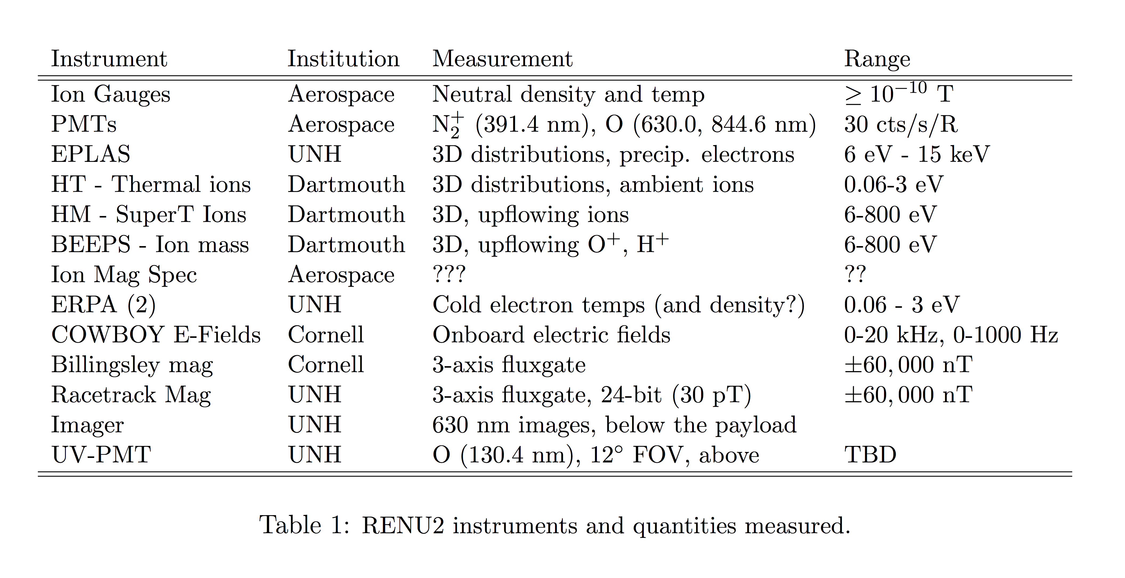
Rocket Experiment for Neutral Upwelling 2 (RENU2)

Slide 2
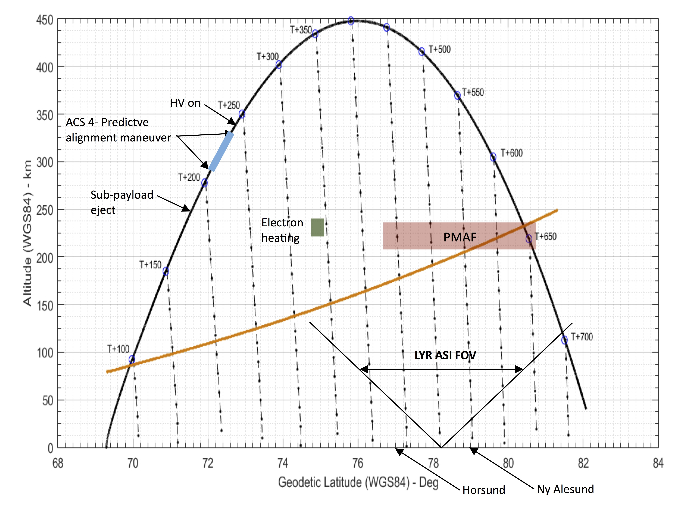
RENU2 observations
Launch an appropriately instrumented sounding rocket through the cusp region (e.g., over Svalbard) during an event with soft electron precipitation and Joule heating. Include relevant ground observations.
EISCAT
BEAM

Slide 3
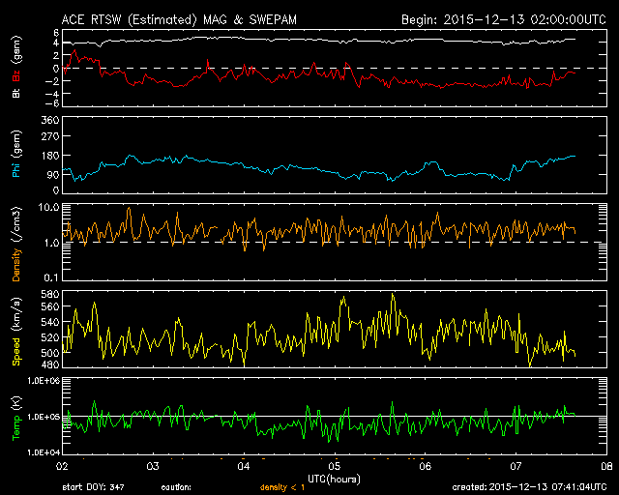
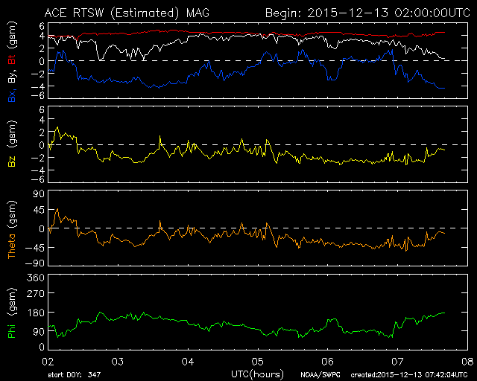
RENU2 Launch
Context – solar wind observations
Data from the ACE satellite at L1. Note negative Bz and positive By; typical density but high solar wind speed. Estimated propagation time of approximately 50 minutes.

Slide 4
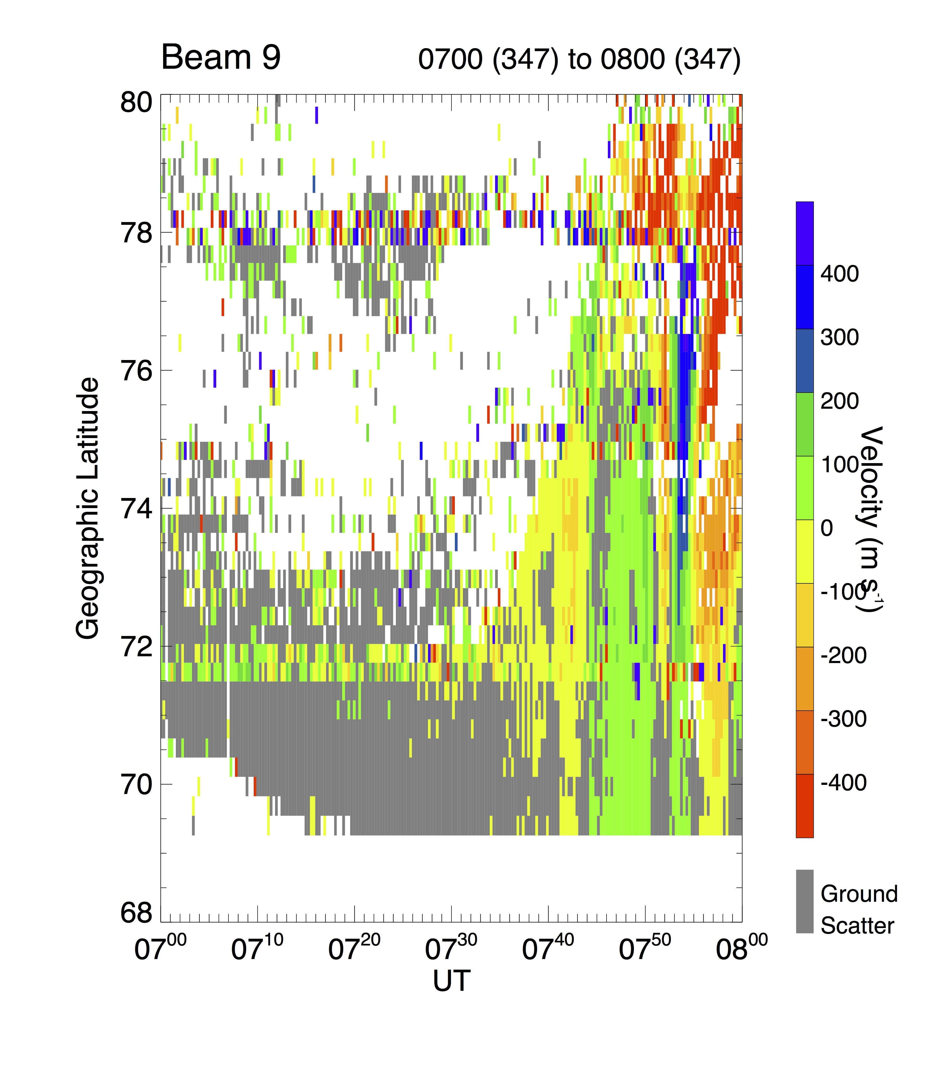
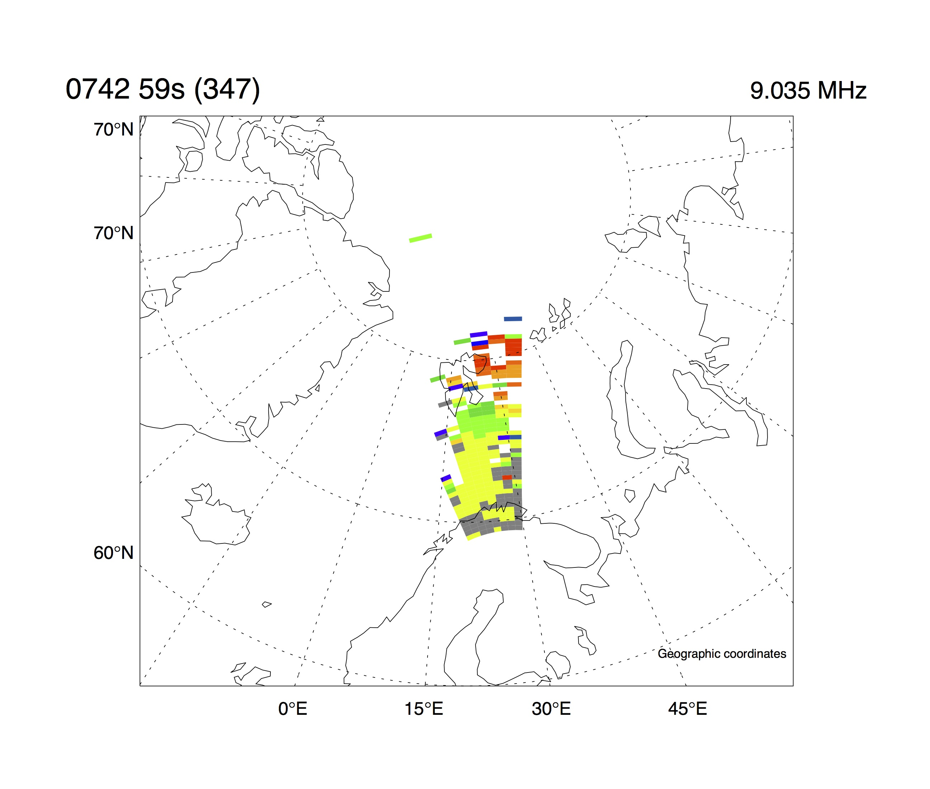
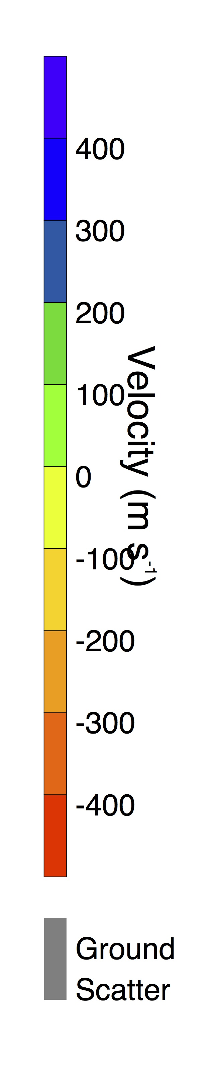
RENU2 Launch
Context – Cutlass (SuperDARN) radar
Evidence from Finland of our rotation into the cusp – the onset of poleward ionospheric flows. Launch was at 07:34 UT.
A 2-D snapshot of radar observations confirming that “we are in the cusp”, 9 minutes after launch

Slide 5
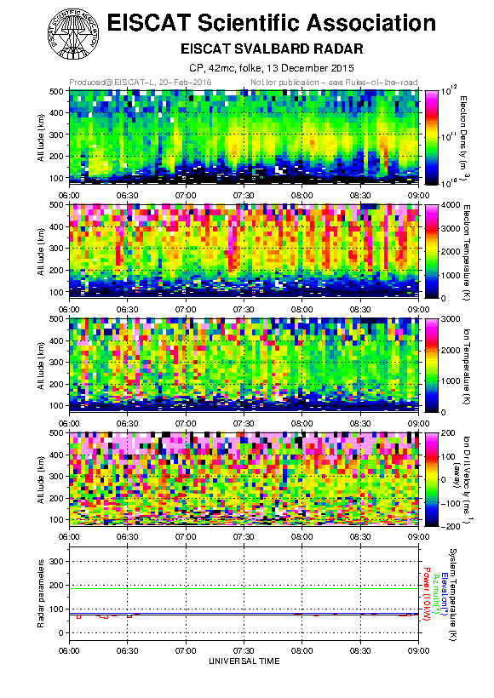
RENU2 Launch
Context – EISCAT radar
1) Several transient enhancements in the electron density in F-region (consistent with the cusp).
2) Several transients in electron temperature, which would be consistent with PMAF activity
3) Joule heating mostly seen in the hour prior to launch, but maybe some weak Joule heating around 07:38 - 07:48 UT.
4) Weak ion upflow in topside region (above 400 km altitude) throughout. Around 07:34 - 07:48 UT, ion upflow appears to have been extending all the way down to 300 km altitude.

Slide 6
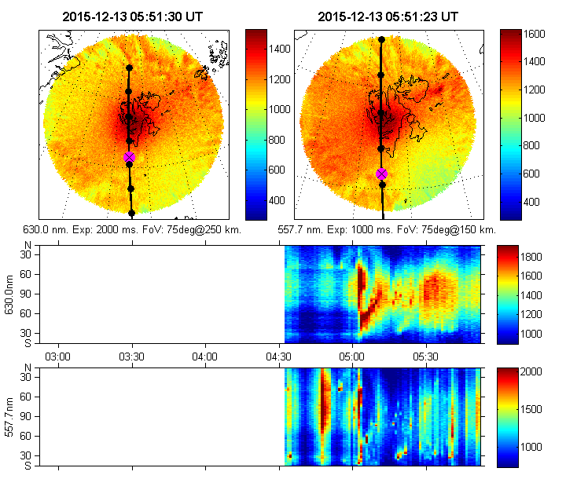
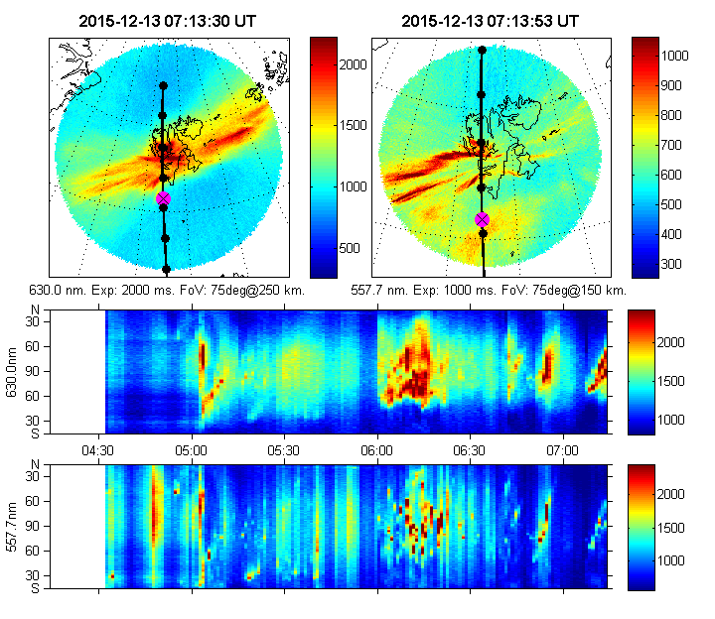
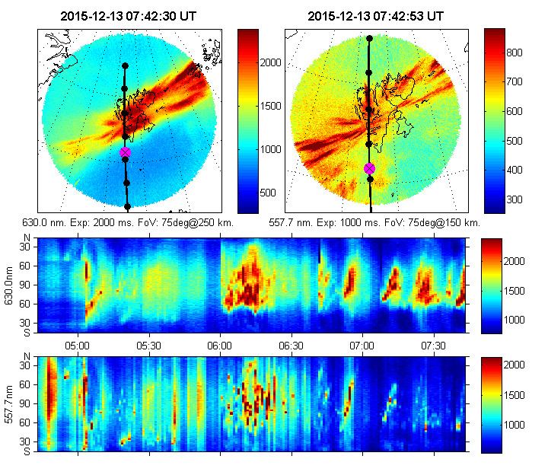
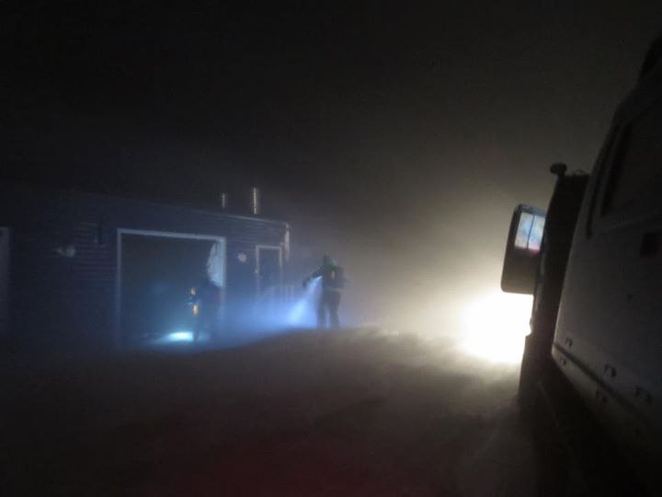
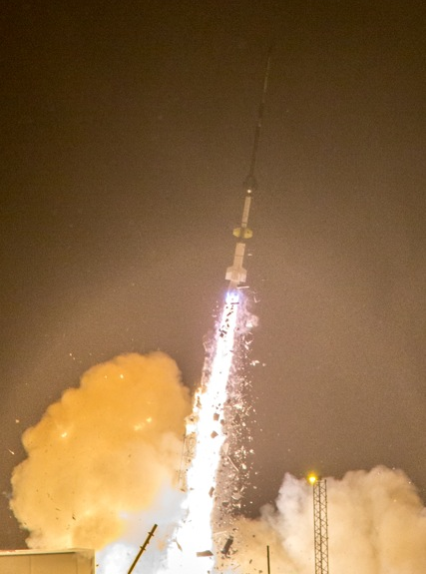
RENU2 Launch
Context – allsky camera data
5:51:30
7:13:30
7:42:30

Slide 7
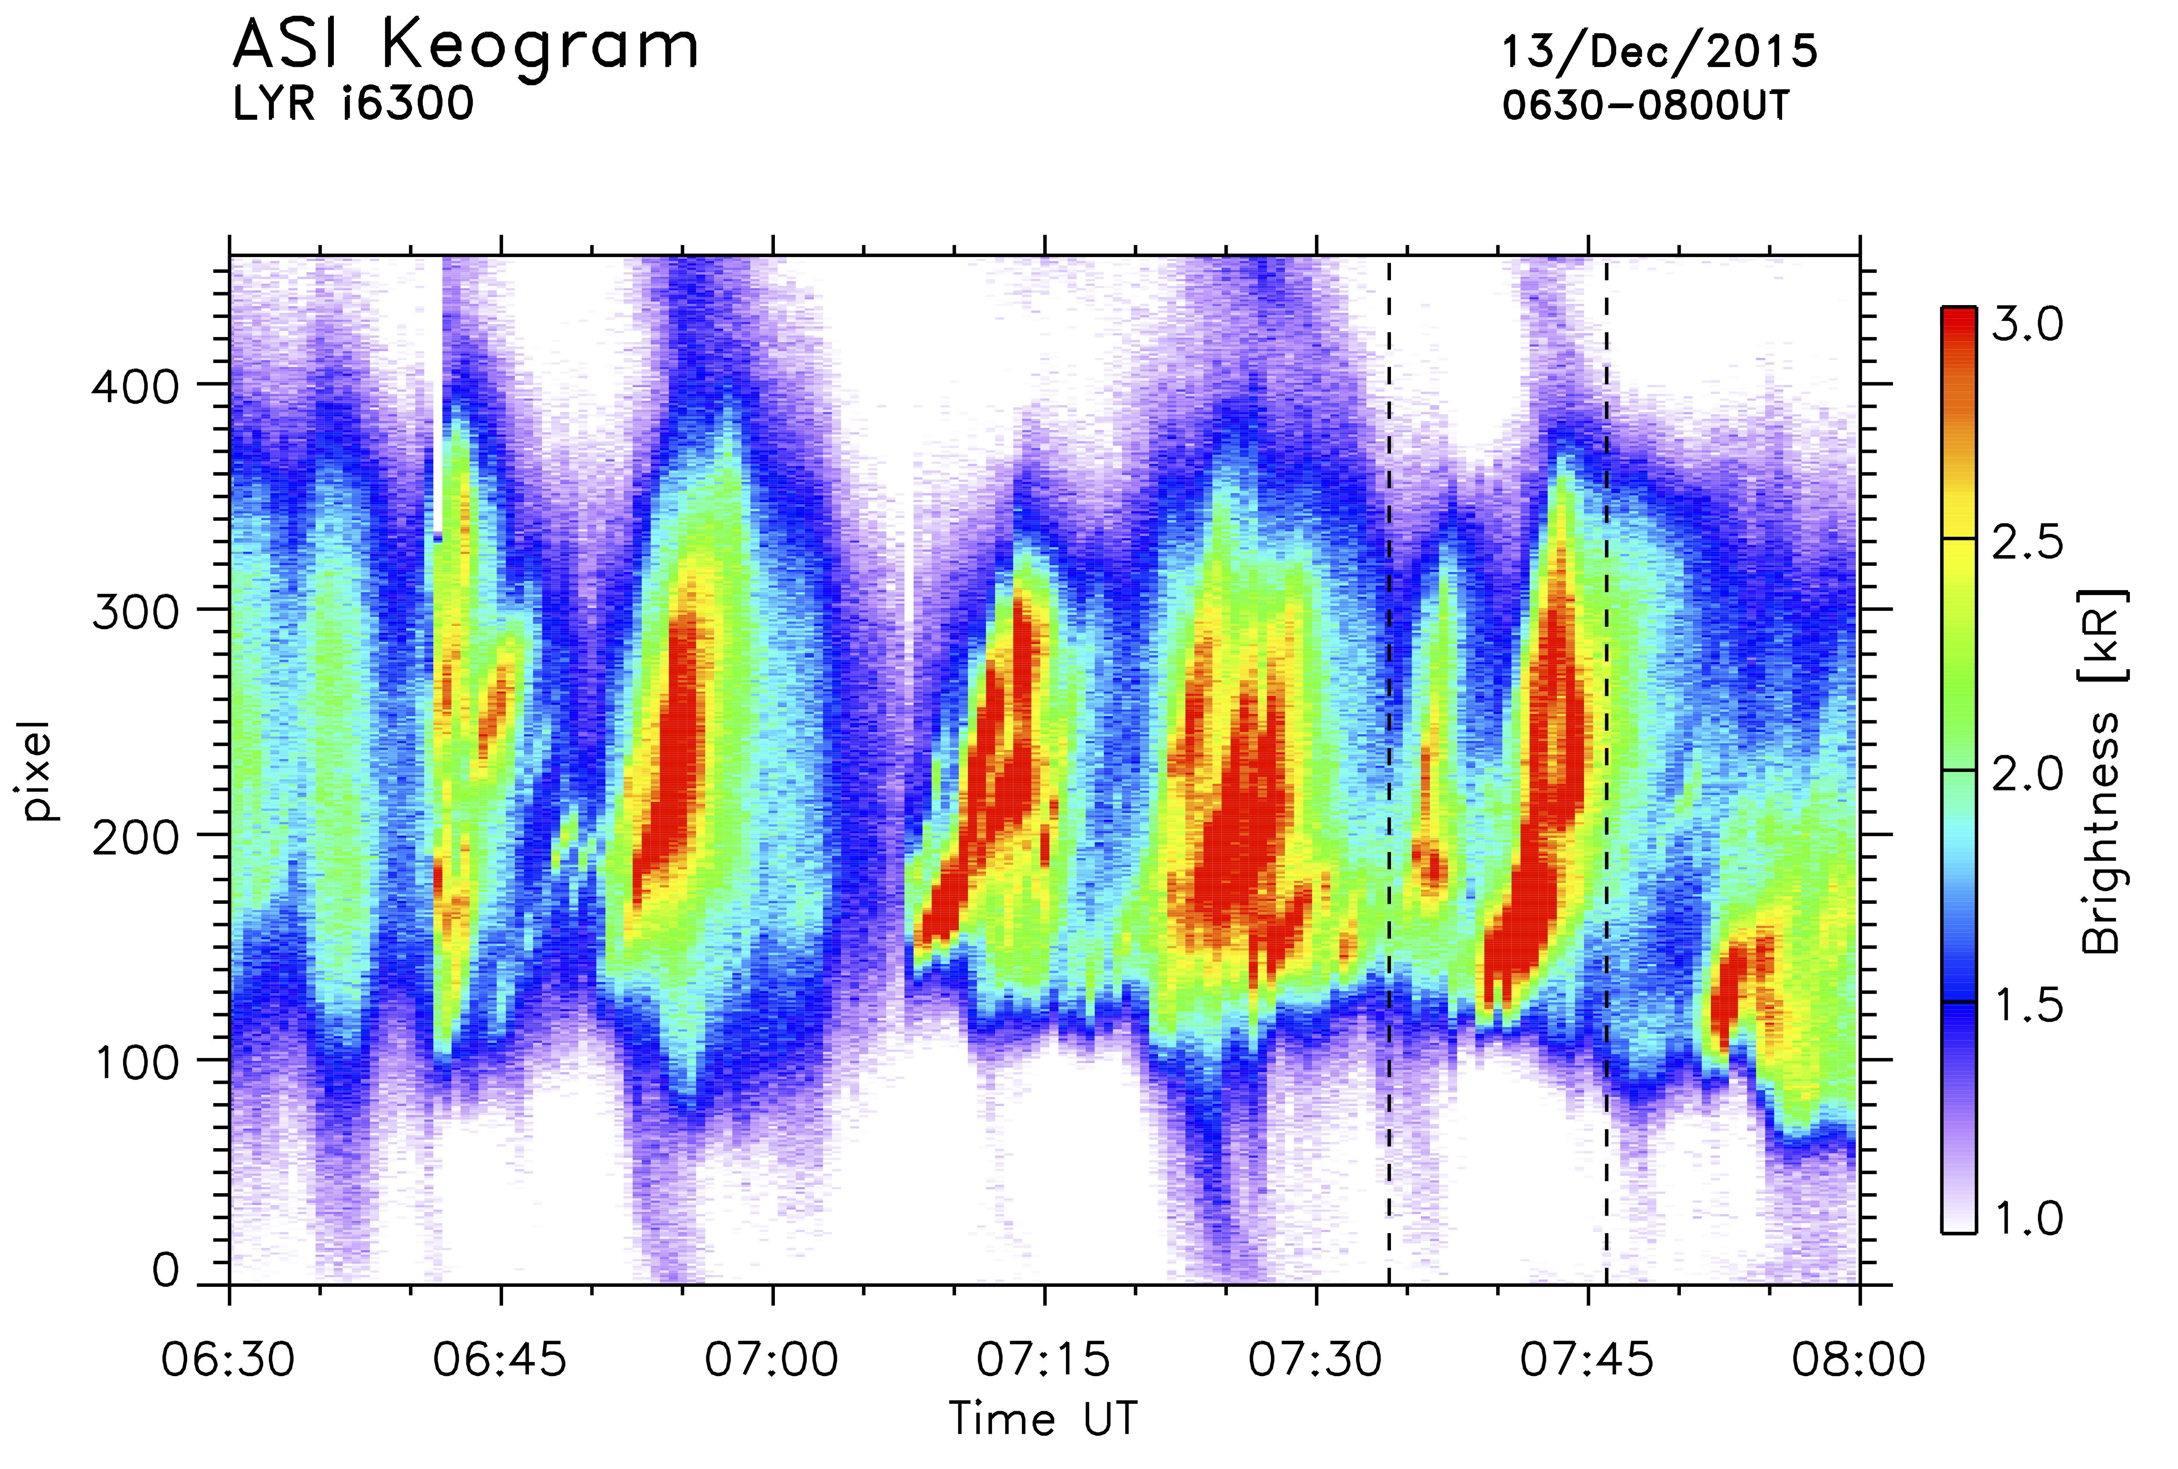
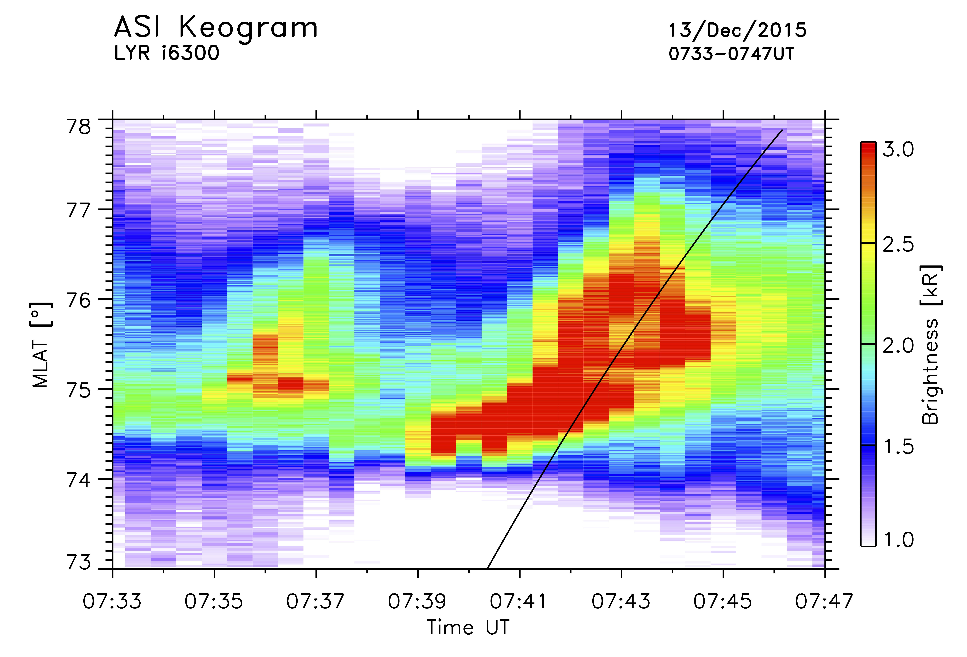
RENU2 Launch
Context
Notes:
5:45 “snow falling hard”
6:08 “less snow, seeing stars”
6:48 “inside the cusp?”
6:58 “clearing snow from domes”
7:00 take the clock to T-15:00
7:14 Drop from T-15:00 to T-2:00
7:27 Hold at T-2:00
7:32 Pick up the count
7:34 LAUNCH!

Slide 8
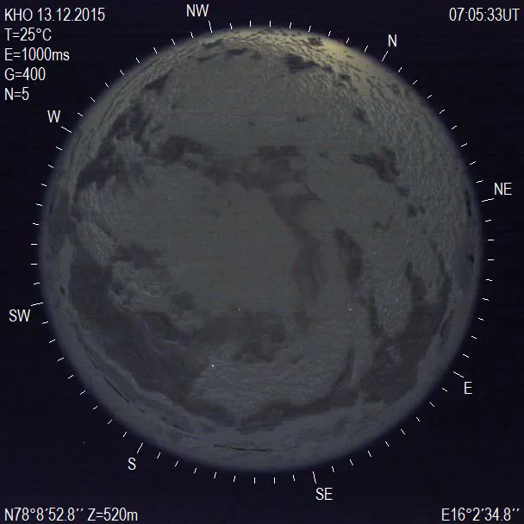
RENU2 Launch
PMAF fine structure – a series of thin arcs

Slide 9
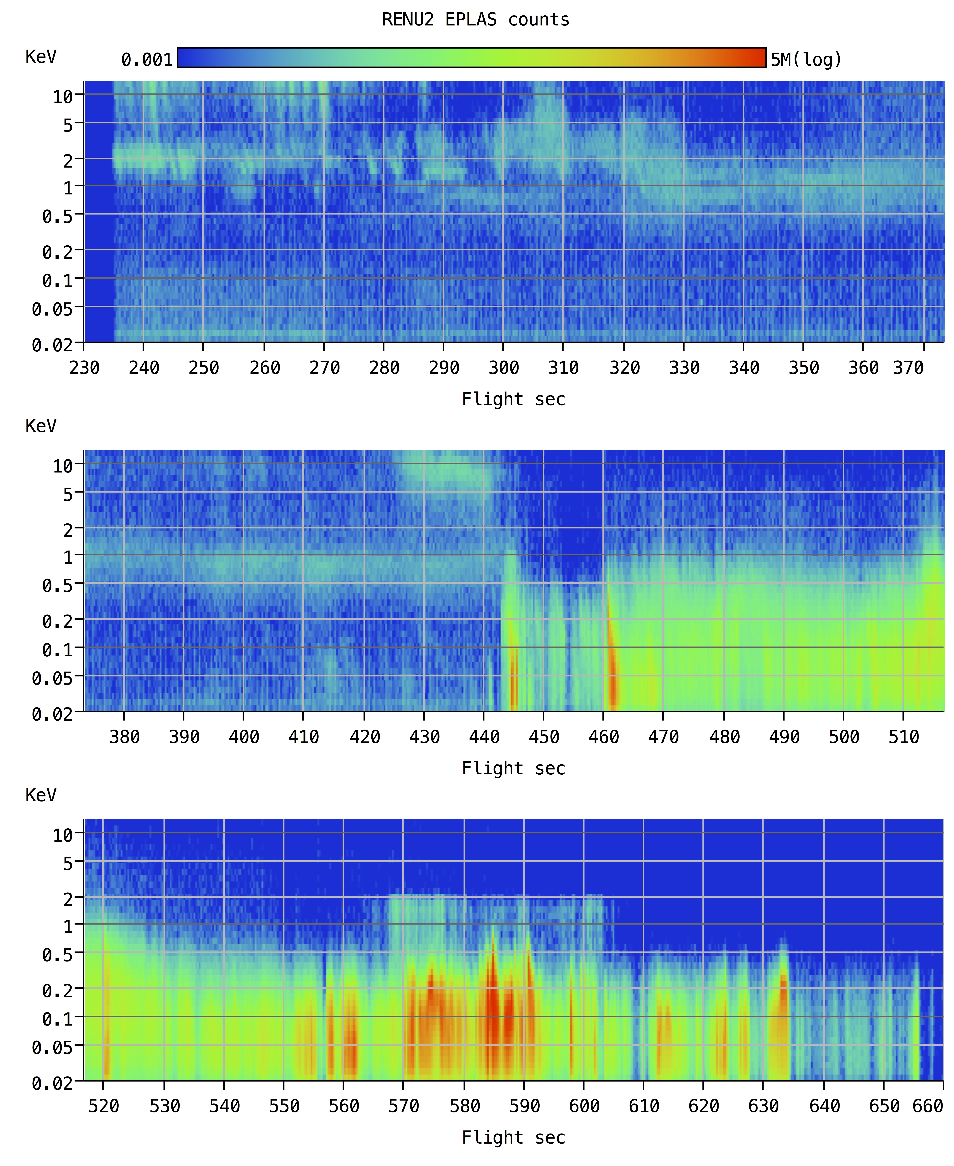
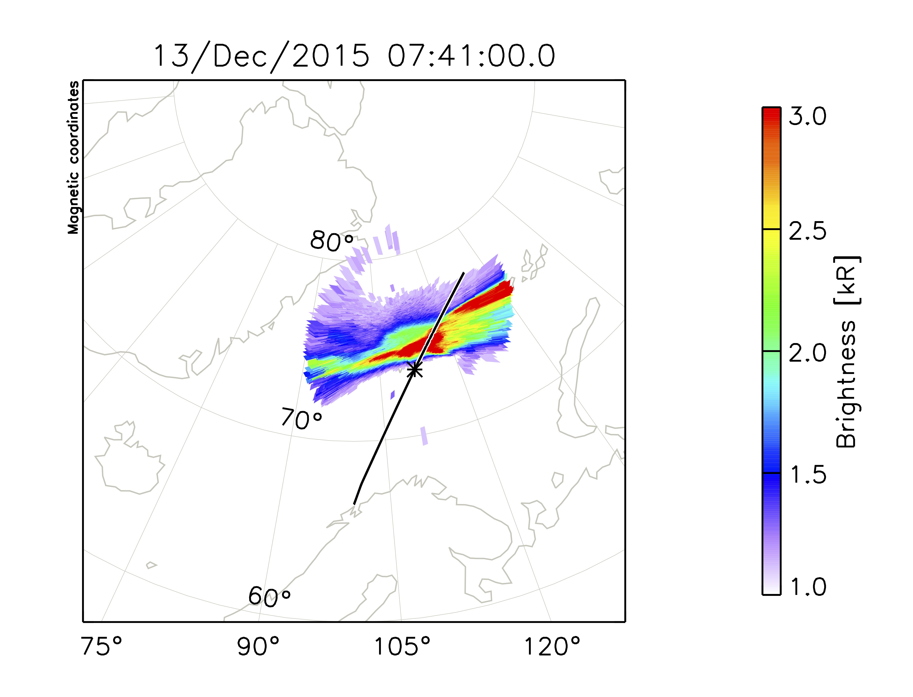
RENU2
Data – electron precipitation
Apogee of 447 km at T+409
Isotropic
Field-aligned!

Slide 10
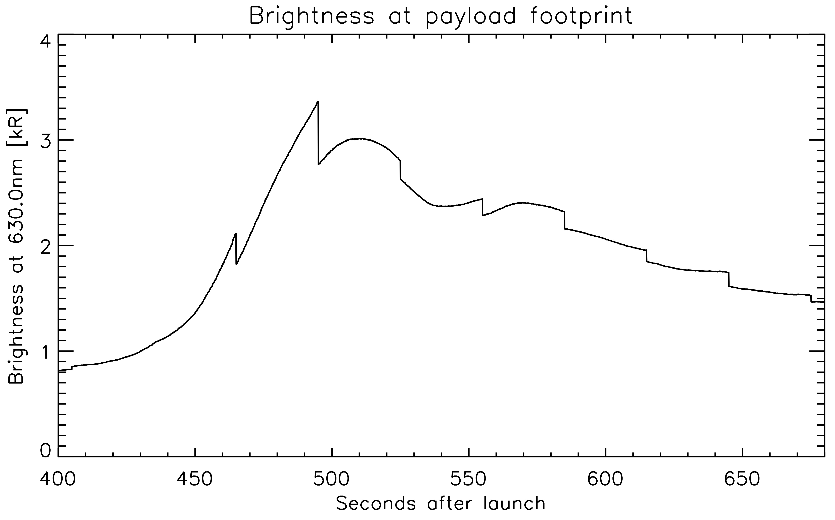
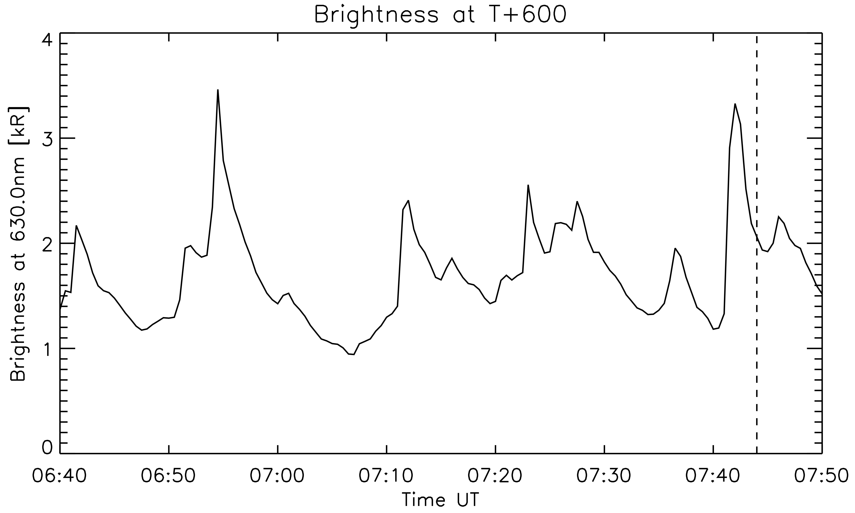
RENU2
Data – electron precipitation

Slide 11
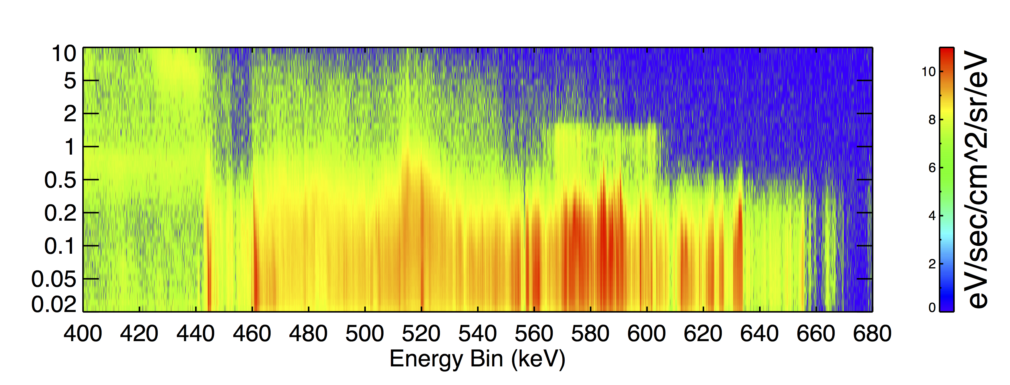
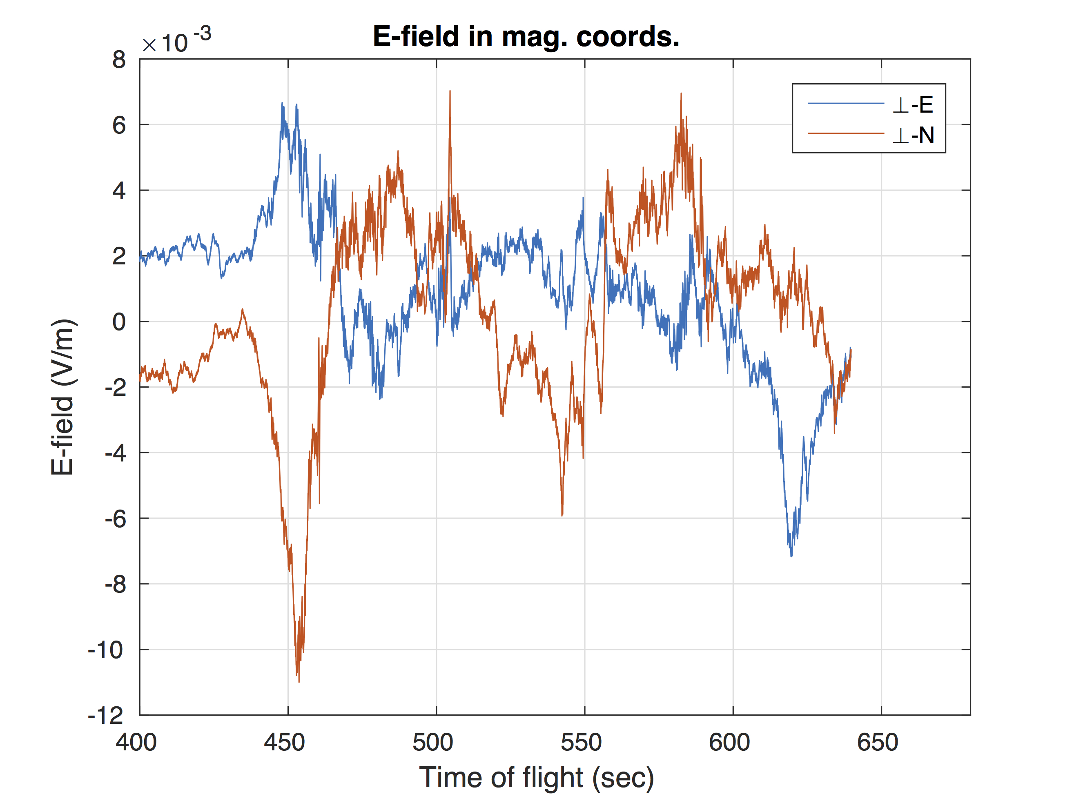
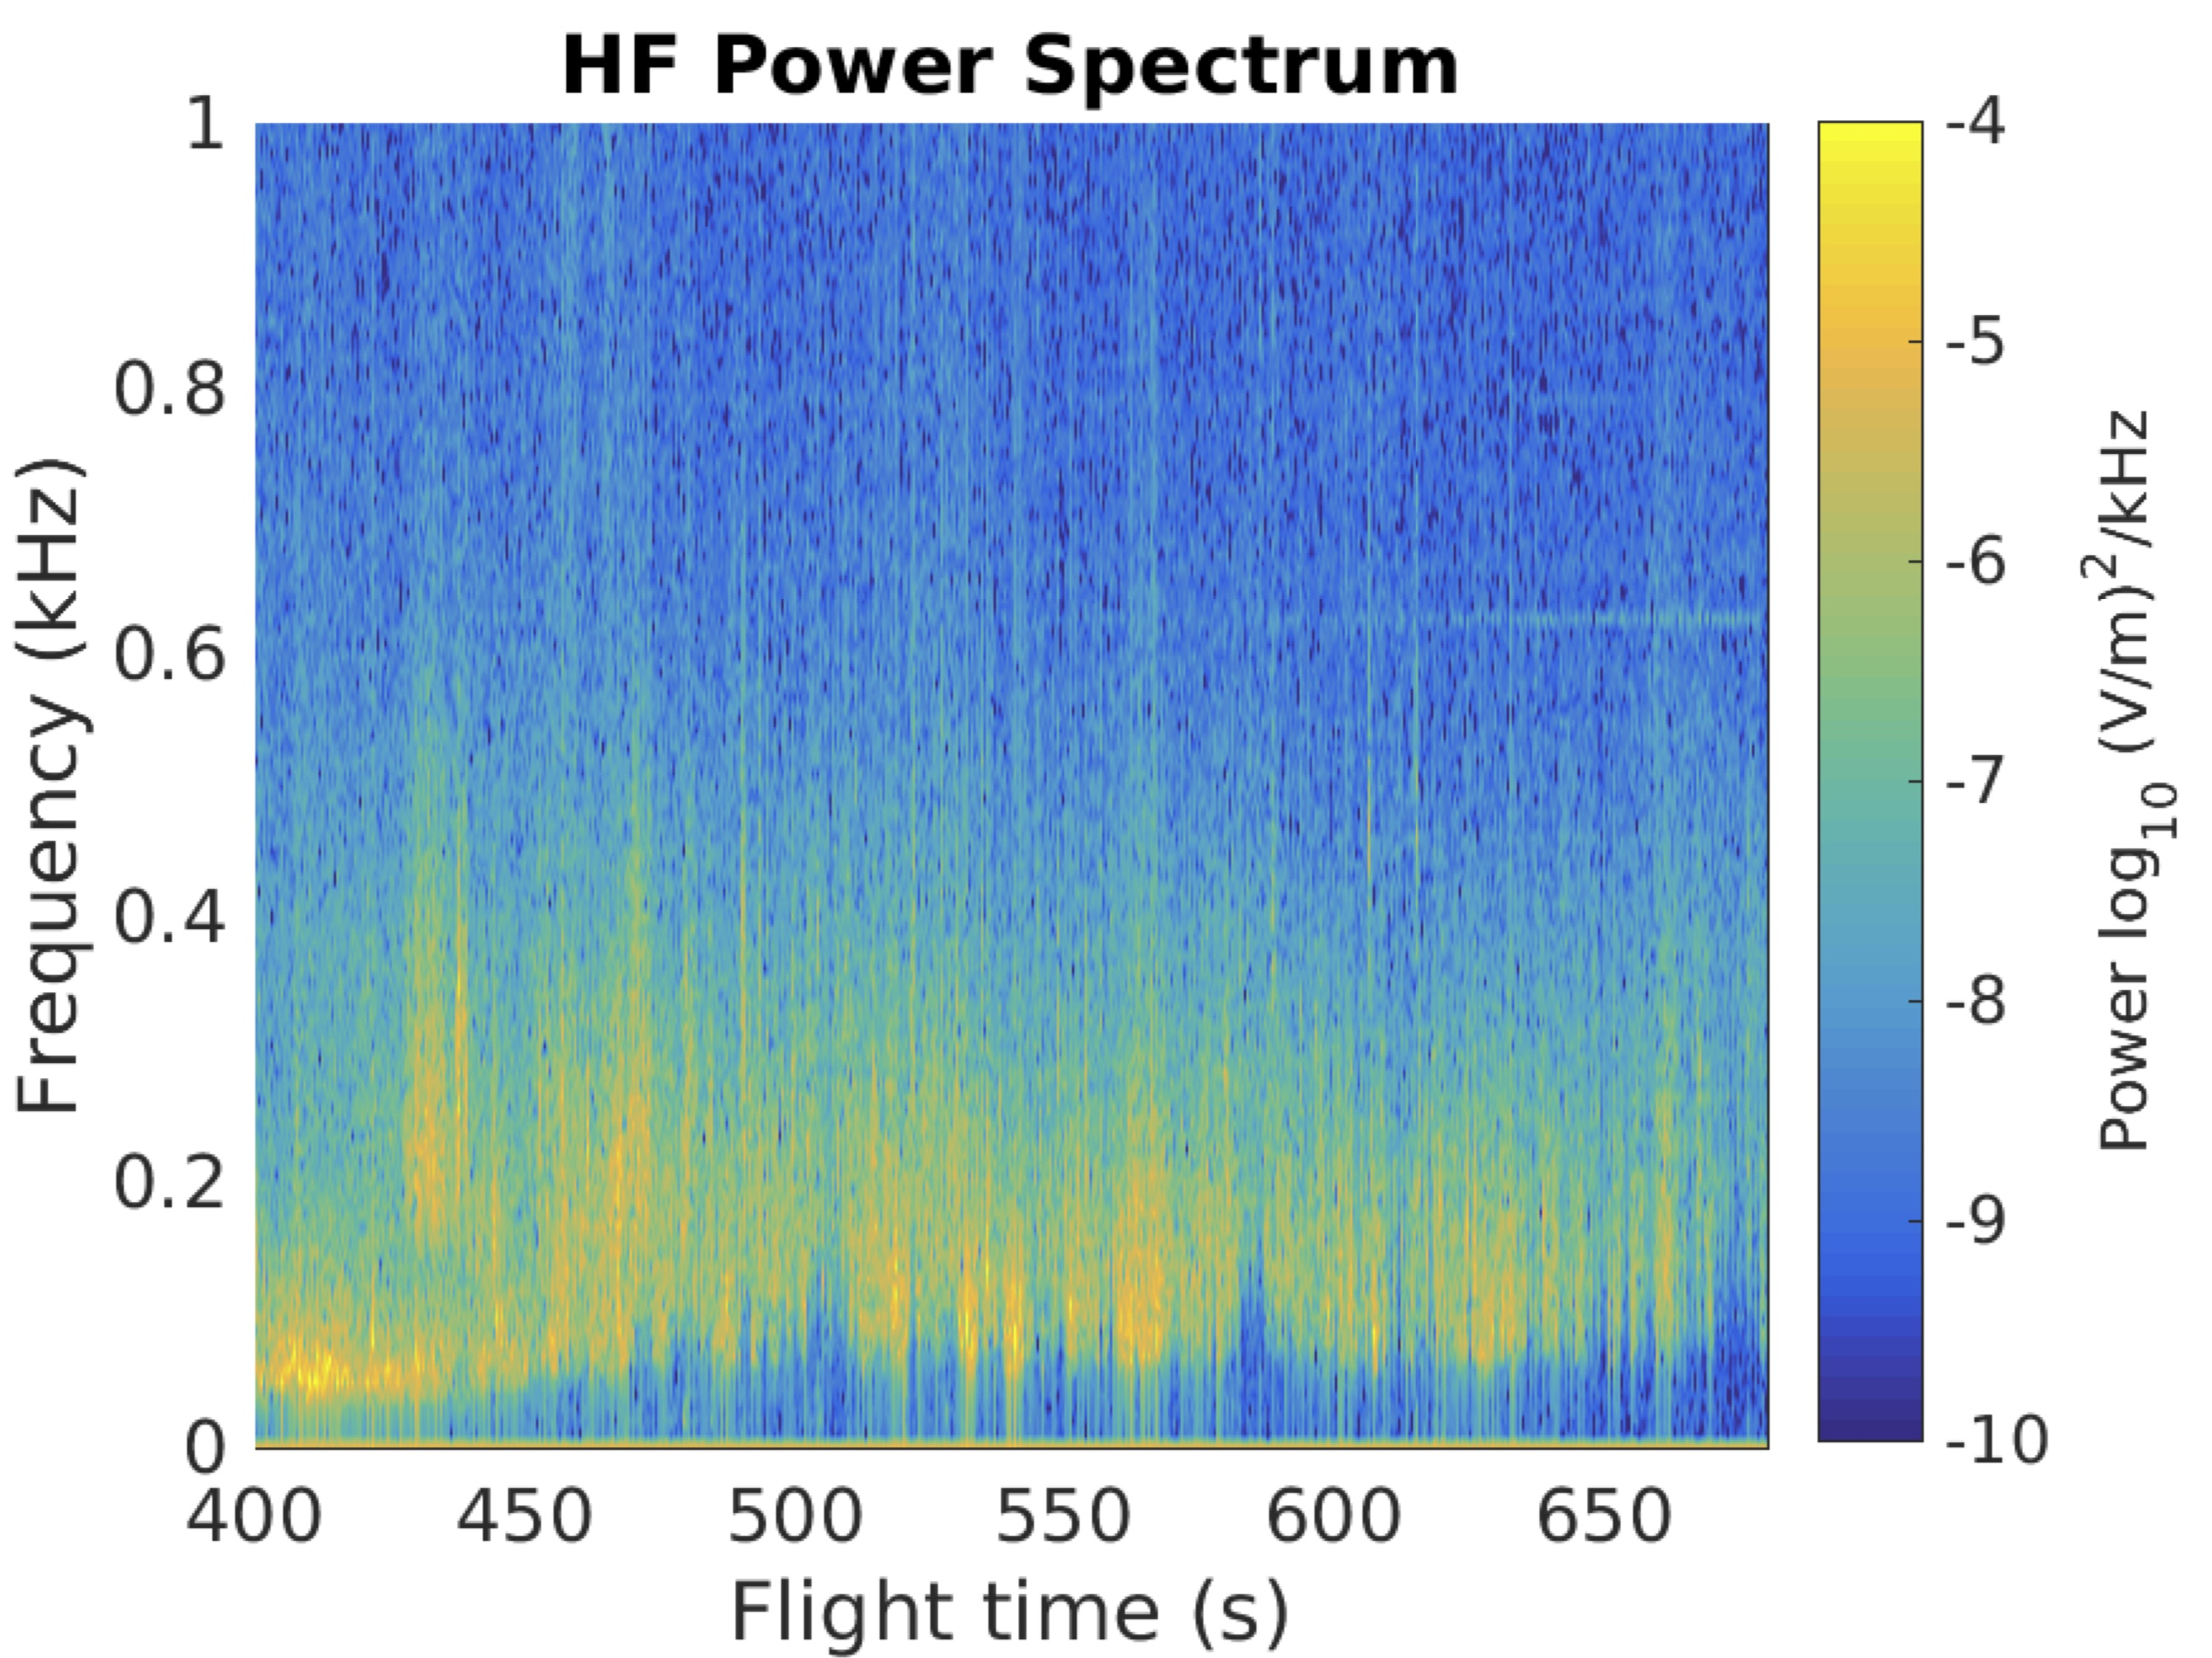
RENU2
Data – electric fields
DC fields show counter-
streaming flow channels. At 450s, E_south ~ 2* E_east, which implies a SE-NW Efield vector or a NE-SW flow channel. The patterns flips polarity through the flight.

Slide 12
RENU2
Conclusions, questions and some topics of interest
1. The payload seems to have been completely successful and appears to have observed neutral upwelling in the region above an arc. We should have the data to feed all relevant models.
2. This is the first in-situ observation of N2+ emissions (sunlit aurora) with other measurements and appears to bring N2+ into the ion outflow story.
3. The electron precipitation may be driven by Alfven waves. what is the connection between the stepped ion precipitation and these waves -- both signatures of reconnection?
4. The ambipolar field is something that can be calculated from EISCAT data (R. Varney).
5. What is the connection between the electron precipitation and ion heating, seen during the most intense portion of the flight?

