Slide 1
UV Emission of Atomic Oxygen
…and why it matters for RENU 2
Bruce Fritz

Slide 2
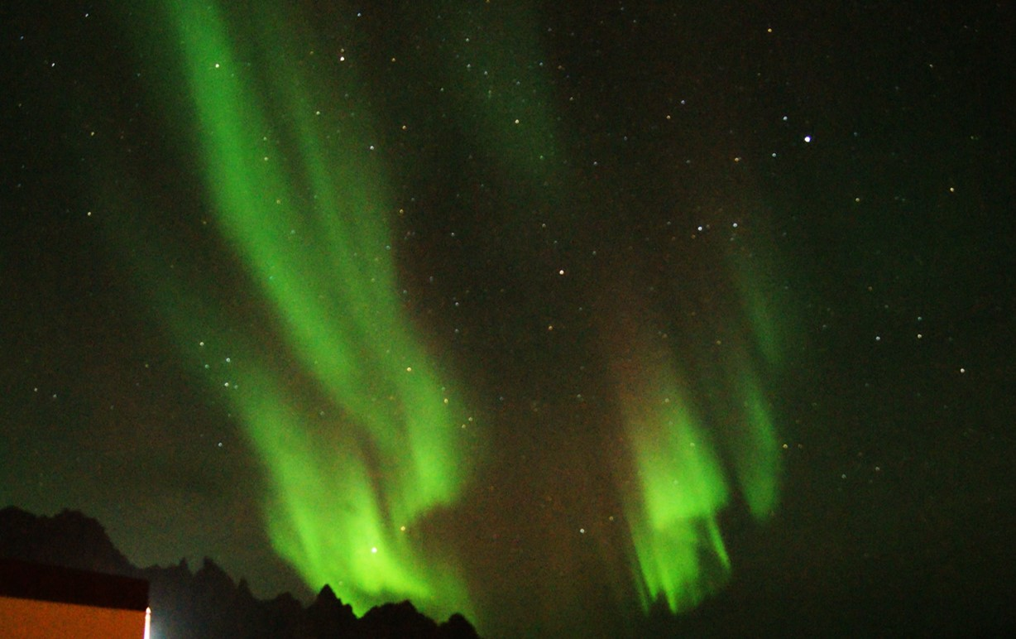
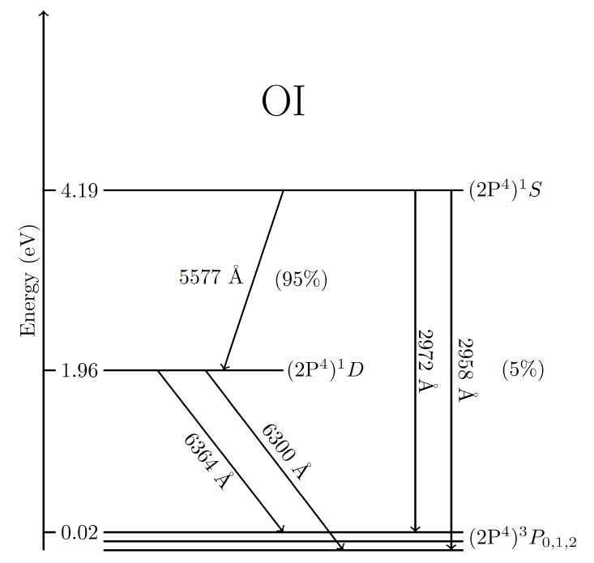
630.0 nm
O (¹D → ³P)
(110 s)
391.4 nm
N₂⁺
557.7 nm
O (¹S → ¹D)
(~0.7 s)

Slide 3
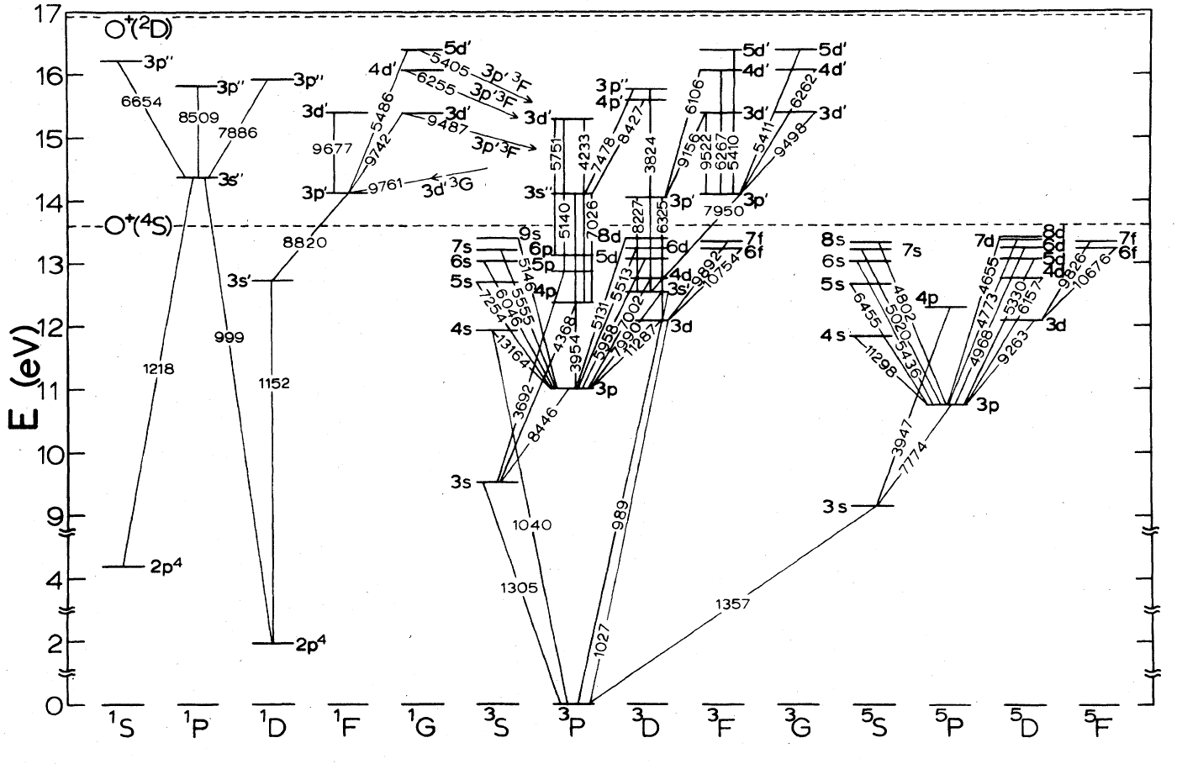
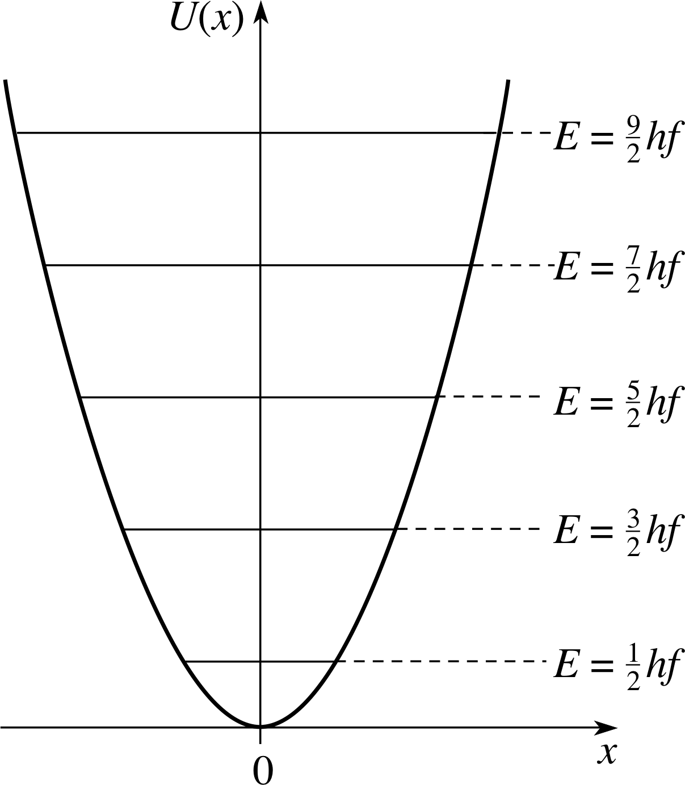
Partial O I energy-level diagram
130.4 nm
135.6 nm
Schulman et al [1985]

Slide 4
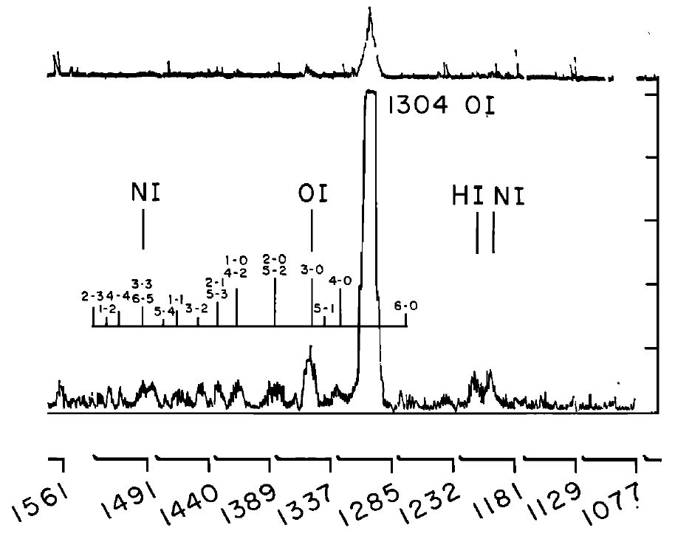
Auroral FUV Spectrum
Miller et al [1968]

Slide 5
Possible excitation mechanisms
Collisional excitation
(Radiative) Recombination
Resonant excitation
Dissociative Recombination
Collisional dissociative excitation

Slide 6
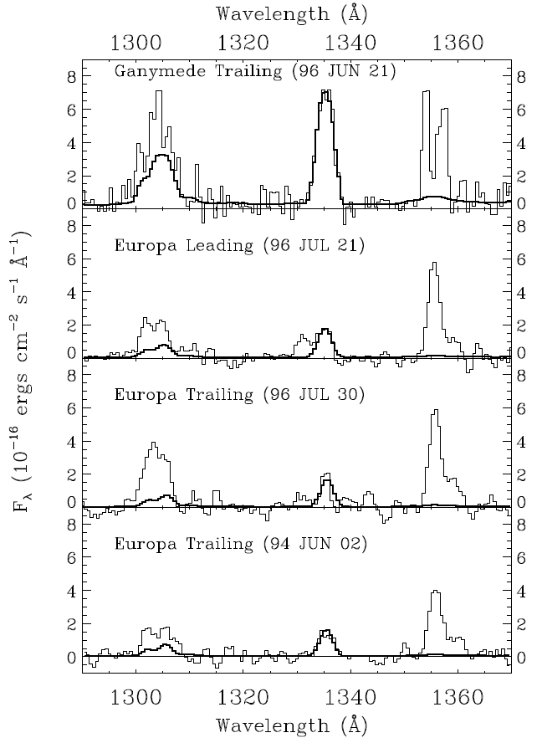
Hubble observations
Distance to Jupiter ~ 5.3 AU
Hall et al [1998]

Slide 7
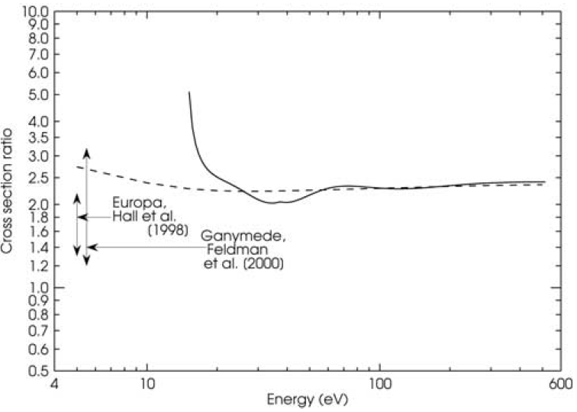

Cross-section ratio vs. energy
$$ratio=\frac{σ(135.6 nm)}{σ (130.4 nm)}$$
Monoenergetic e⁻ flux
Maxwellian e⁻ flux
Kanik et al [2003]

Slide 8
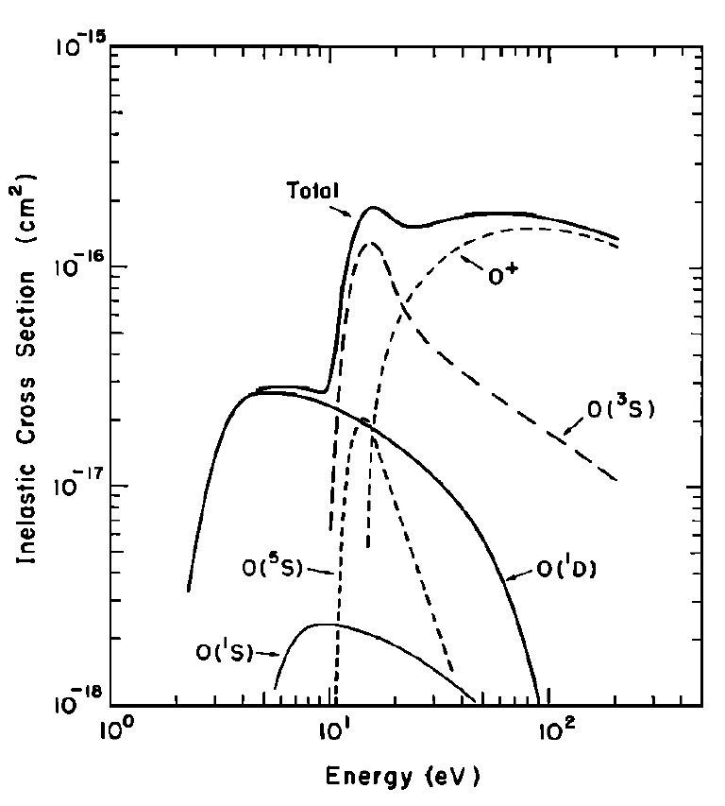
Inelastic cross sections for OI
130.4 nm cross section dominant
Much larger total cross section
Zipf and Stone [1971]

Slide 9
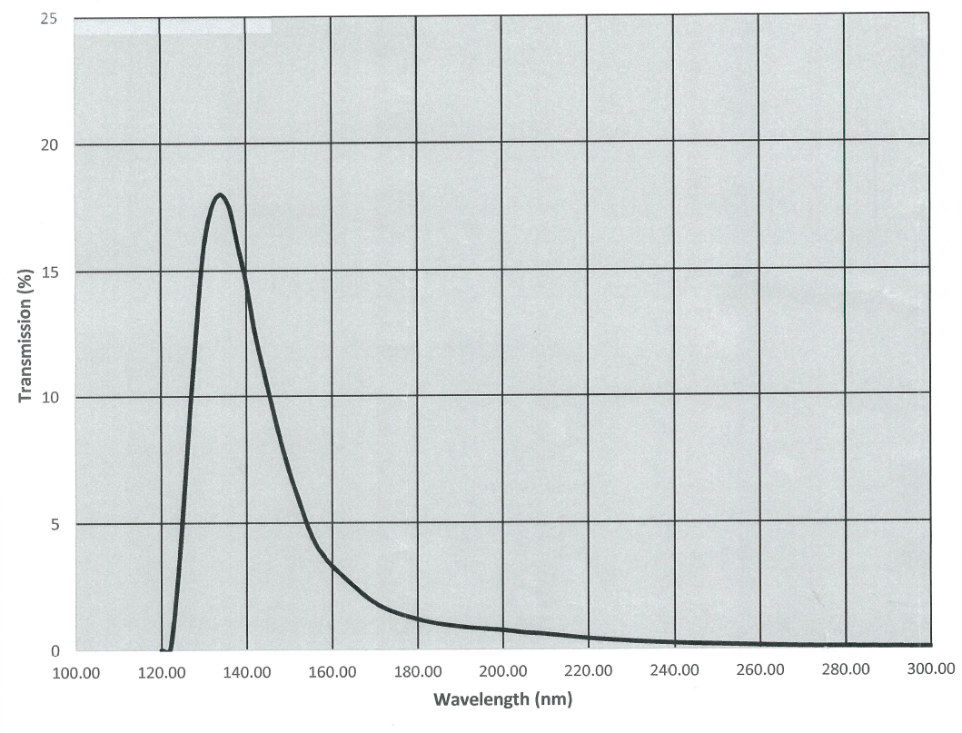
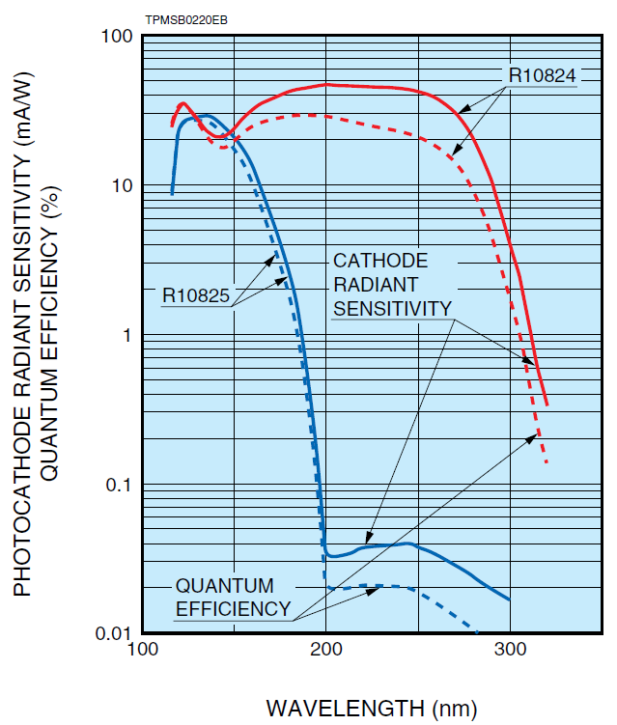
UV PMT
Filtered to include both lines

Slide 10
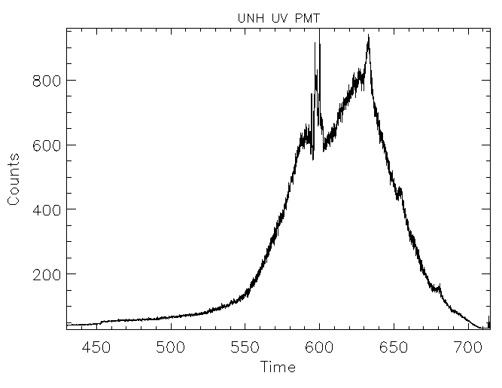
UV PMT

Slide 11
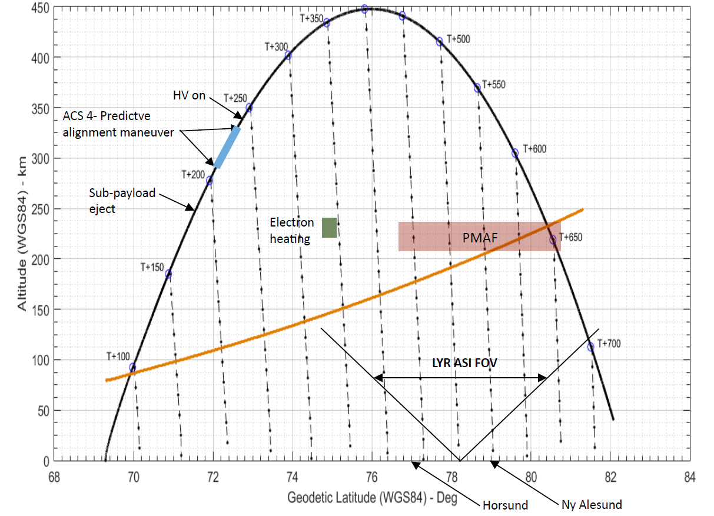
UV PMT

Slide 12
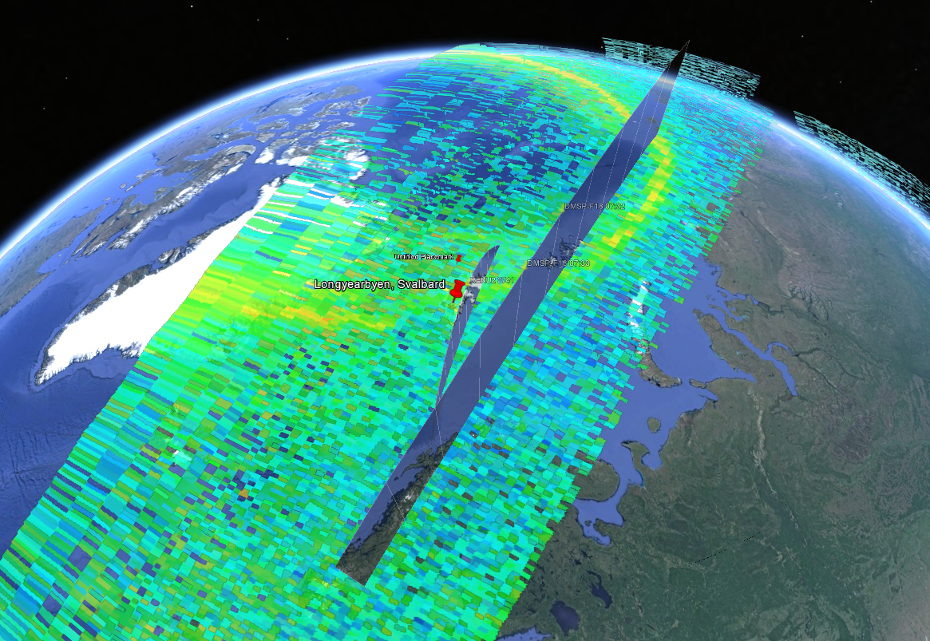
DMSP SSUSI
RENU 2
DMSP

Slide 13
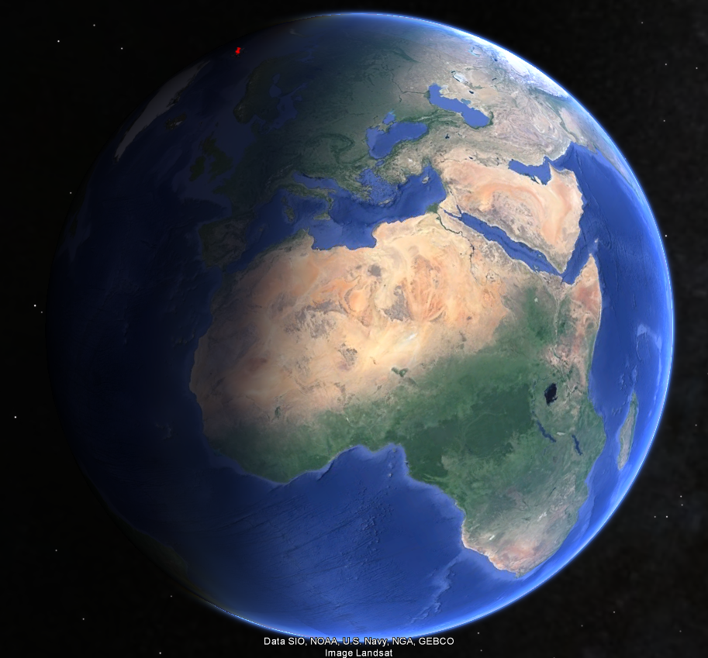
RENU 2 trajectory
90°
LYR

Slide 14
Continued work
Calibration of PMT
Correlation of PMT signal with DMSP data

Slide 15

Questions?

Slide 16
References
Ajello, Joseph M., Dissociative Excitation of O2 in the Vacuum Ultraviolet by Electron Impact, The Journal of Chemical Physics, 55, 3156-3157 (1971), DOI:http://dx.doi.org/10.1063/1.1676562
Feldman, P. D., M. A. McGrath, D. F. Strobel, H. W. Moos, K. D., Retherford, and B. C. Wolven, HST/STIS ultraviolet imaging of polar aurora on Ganymede, Astrophys. J., 535, 1085– 1090, 2000.
Hall, D. T., P. D. Feldman, M. A. McGrath, and D. F. Strobel, The far ultraviolet oxygen airglow of Europa and Ganymede, Astrophys. J., 499, 475–481, 1998.
James, G. K., J. M. Ajello, D. E. Shemansky, B. Franklin, D. Siskind, and T. G. Slanger (1988), An investigation of the second negative system of O2 + by electron impact, J. Geophys. Res., 93(A9), 9893–9902, doi:10.1029/JA093iA09p09893.
Kanik, I., C. Noren, O. P. Makarov, P. Vattipalle, J. M. Ajello, and D. E. Shemansky, Electron impact dissociative excitation of O2: 2. Absolute emission cross sections of the OI(130.4 nm) and OI(135.6 nm) lines, J. Geophys. Res., 108(E11), 5126, doi:10.1029/2000JE001423, 2003.
Miller, R. E., W. G. Fastie, and R. C. Isler (1968), Rocket studies of far-ultraviolet radiation in an aurora, Journal of Geophysical Research, 73(11), 3353{3365, doi:10.1029/JA073i011p03353.
Noren, C., Kanik, I., Ajello, J. M., McCartney, P., Makarov, O. P., McClintock, W. E. and Drake, V. A. (2001), Emission cross section of O I (135.6 nm) at 100 eV resulting from electron-impact dissociative excitation of O₂. Geophys. Res. Lett., 28: 1379–1382. doi:10.1029/2000GL012577
Shemansky, D. E., J. M. Ajello, and D. T. Hall, Electron impact excitation of H2: Rydberg band systems and the benchmark dissociative cross section for H Lyman-a, Astrophys. J., 296, 765–773, 1985a.
W.C. Wells, W.L. Borst, E.C. Zipf, Absolute cross section for the production of O(5S0) by electron impact dissociation of O2, Chemical Physics Letters, Volume 12, Issue 2, 1971, Pages 288-290, ISSN 0009-2614, http://dx.doi.org/10.1016/0009-2614(71)85066-2.
Zipf, E. C., and E. J. Stone (1971), Photoelectron excitation of atomic-oxygen resonance radiation in the terrestrial airglow, J. Geophys. Res., 76(28), 6865–6874, doi:10.1029/JA076i028p06865.

